Slide 1

COMMUNITY
CONVERSATION
HIGHLIGHTS FROM THE 2022 YOUTH & COMMUNITY SURVEYS

Slide 4
What do you think?
using Marijuana one or two times a week?
having one or two alcoholic drinks nearly every day?
using E-cigarettes or vaping?
PERCEPTIONS OF HARM
YOUTH vs PARENTS
We asked youth how much they think people risk harming themselves when they use various substances.
We asked parents how much they think youth in their child’s oldest grade risk harming themselves when they use these same substances.

Slide 6
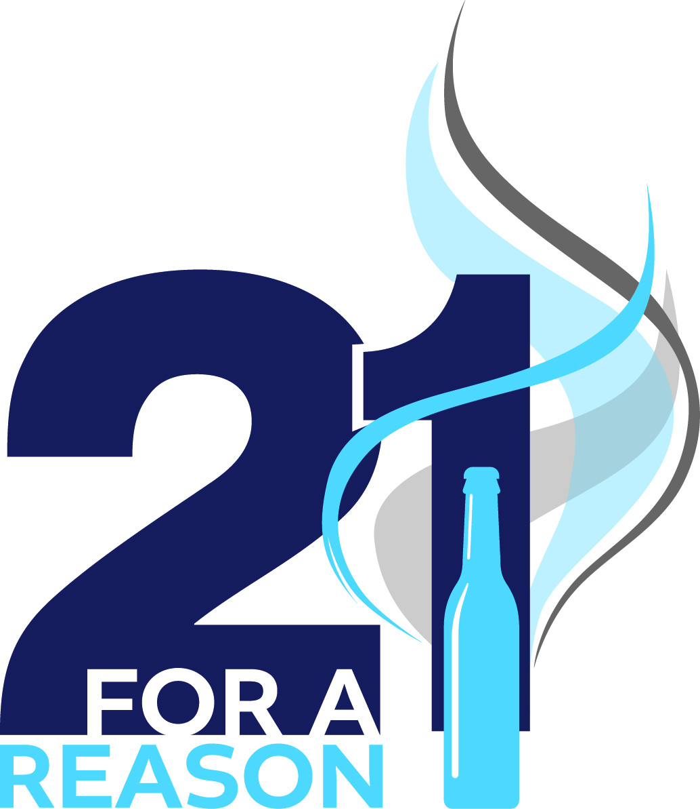
The adolescent and teen years are a time of critical growth—and alcohol, marijuana and nicotine can have long-term, irreversible effects on the body and the brain.
Alcohol consumption can impair judgement which can put young people in danger of car crashes, injuries, sexual assault, and more.
Risks of marijuana use include impaired memory, reduced cognitive abilities, mental health issues, and substance misuse problems.
Use of Marijuana during teen years can increase likelihood of developing a cannabis use disorder by 4 to 7 times.
Many teens don’t realize that vape cartridges usually contain nicotine- one cartridge can be equivalent to smoking an entire pack of cigarettes
DISCUSSING RISKS
Connecticut’s 21 For A Reason campaign provides information to parents and youth about the risks of underage use of marijuana, alcohol and vaping products.

Slide 8
“What was your age, in years, when you FIRST used the following?”
  Cigarettes
  Marijuana
  Alcoholic Beverages
When do you think most youth report first using?
Age of Initiation
The earlier a person’s brain is exposed to a drug, the more likely they are to develop dependence and addiction later in life.

Slide 9
Age of Initiation of Use
Among youth who reported ever having used

Slide 10

Top Reasons For Choosing NOT to Use
I don’t approve of it
My parents disapprove of it
It doesn’t interest me
It might harm my physical health
I don’t want to lose control of myself
It might interfere with my schoolwork
Have frequent conversations with your child about the risks of underage substance use.
Help your child identify their own reasons not to use.
Discuss refusal skills: how your child can respond in social situations.
Be clear about your family’s rules and the consequences.
Talk. They Hear You.
www.samhsa.gov/talk-they-hear-you

Slide 12
What do you think?
What do you think youth and parents said?
Were their answers different?
Clear Rules
YOUTH vs PARENTS
We asked youth if their parents have set clear rules about using various substances.
We asked parents if they have set clear rules for their children about using various substances.

Slide 13

Survey results show that almost all parents report that their family has clear rules discouraging substance use.
However, just about 6 out of 10 Middle School youth reported the same.
But among High School youth, the number increases to 8 out of 10 youth reporting their family has clear rules.
Think back to the age that many youth report first trying alcohol, marijuana and cigarettes- between 11 and 13 years old!
This leaves room for parents to have these discussions with their middle school children.
97% - 99%
of Parents
67%-68% of MS Youth
81% -86% of HS Youth
Clear Rules

Slide 14
Start EARLY
Speak FREQUENTLY
Be CLEAR
Discuss the CONSEQUENCES
Setting Clear Rules
When parents are clear with their children about the rules and consequences for substance use, youth are less likely to use.

Slide 16
What do you think?
What do you think youth and parents said?
Did their perceptions differ from each other?
Perception of Parental Disapproval
YOUTH vs PARENTS
We asked youth how wrong their parents would think it is for them to use various substances.
We also asked parents how wrong they think it would be for youth in their oldest child’s grade to use various substances.

Slide 18
What do you think?
What do you think youth said?
Perception of Peer Disapproval
We asked youth how wrong their peers would think it is for them to use various substances.

Slide 19
2
Use Marijuana:
5/10 High School youth
Use Marijuana:
9/10 Middle School youth
Drink Alcohol:
5/10 High School youth
Perceptions of Peer Disapproval
Drink Alcohol:
8/10 Middle School youth
How much do youth think friends would disapprove
Use E-cigs:
6/10 High School youth
These numbers represent the number of youth who said their friends would think it was wrong or very wrong.
Use E-cigs:
9/10 Middle School youth

Slide 20
Parent and peer disapproval directly reduces substance use.
Perception of Disapproval
Parent and peer disapproval indirectly influences substance use by altering risk perception

Slide 21
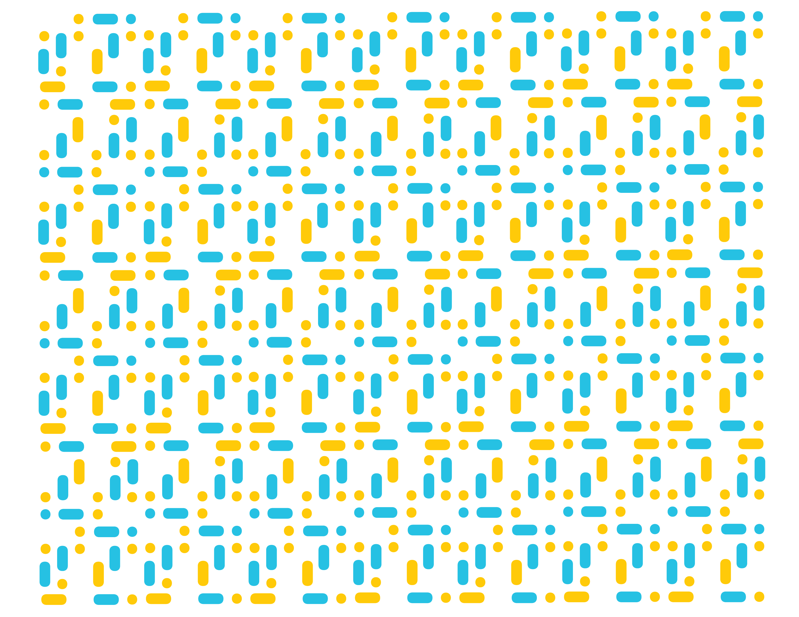

Thank you
(860) 537-7255 | youthservices@colchesterct.gov | colchesterct.gov/yss
Town of Colchester, 127 Norwich Avenue | Colchester, CT 06415

