Slide 1
First Selectman’s Presentation
Andreas Bisbikos, First Selectman

Slide 2

Agenda
Parking Lot
Police Expansion/Youth Center/Food Bank
Funding Sources
The Future to Come

Slide 3

Introduction
As First Selectman, I have been working very hard on a variety of projects and initiatives. One of those initiatives has been to address the eye sore at 120 South Main Street (Jack’s Chevrolet building). Throughout my tenure, I have had on going conversations with perspective buyers and the sellers in the hopes of making progress.
Today, I am proud to announce, that a group of buyers have formally signed the contract to purchase the property. The contract becomes official in three weeks. Once the purchase of the property is finalized, I will begin serious negotiations with the buyers on behalf of the Town.

Slide 4
Parking Lot
120 South Main Street

Slide 5
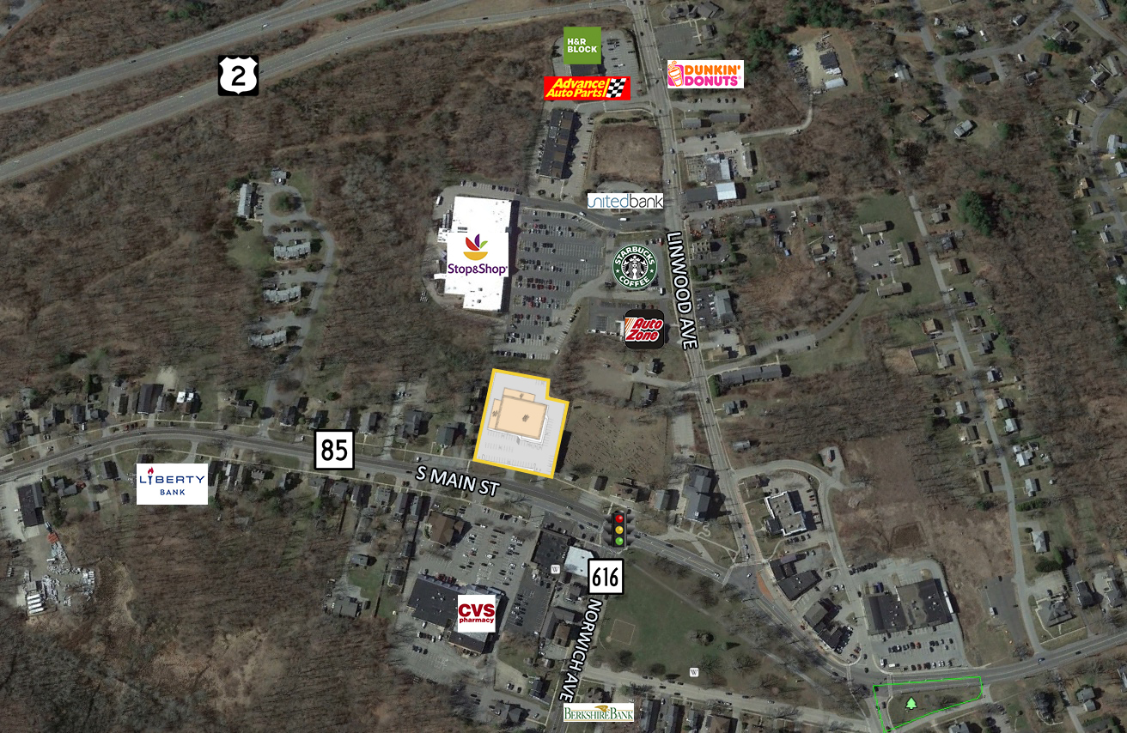
120 South Main Street

Slide 6
Parking Lot
Status
ARPA
A tentative agreement with the prospective buyers has already been struck which would allow the town residents to use the parking lot for any activities related to the Green if the property is bought or leased
Up to 150 parking spots
If the Town does not buy or lease the property, new parking lot access would be negotiated due to additional tenants being involved
ARPA Funding Request: $0

Slide 7
Police Station/Youth Center/Food Bank
120 South Main Street

Slide 8
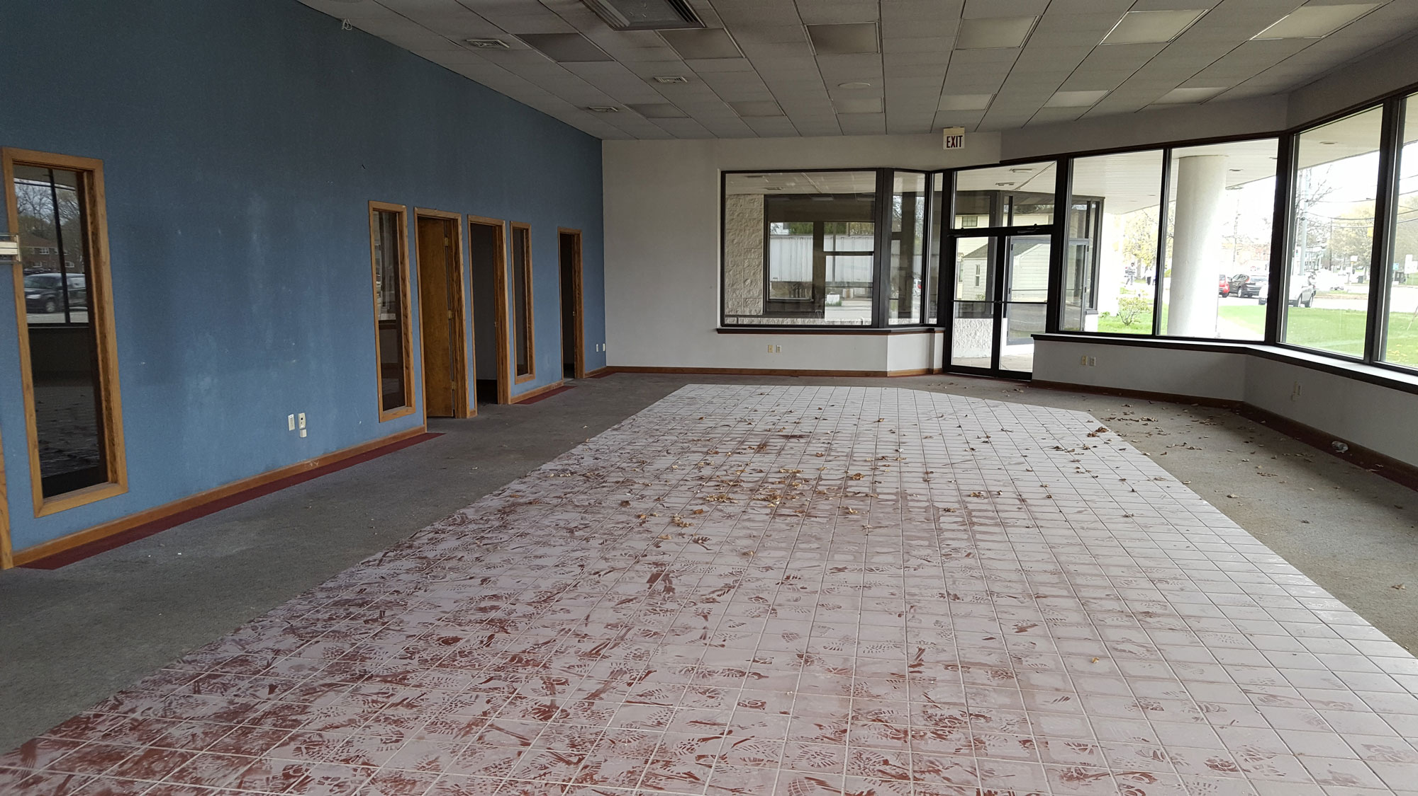
120 South Main Street

Slide 9
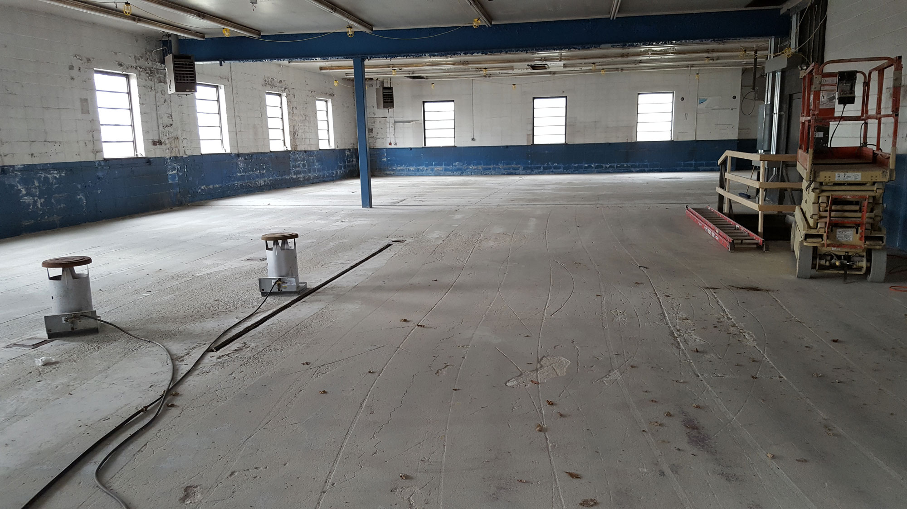
120 South Main Street

Slide 10
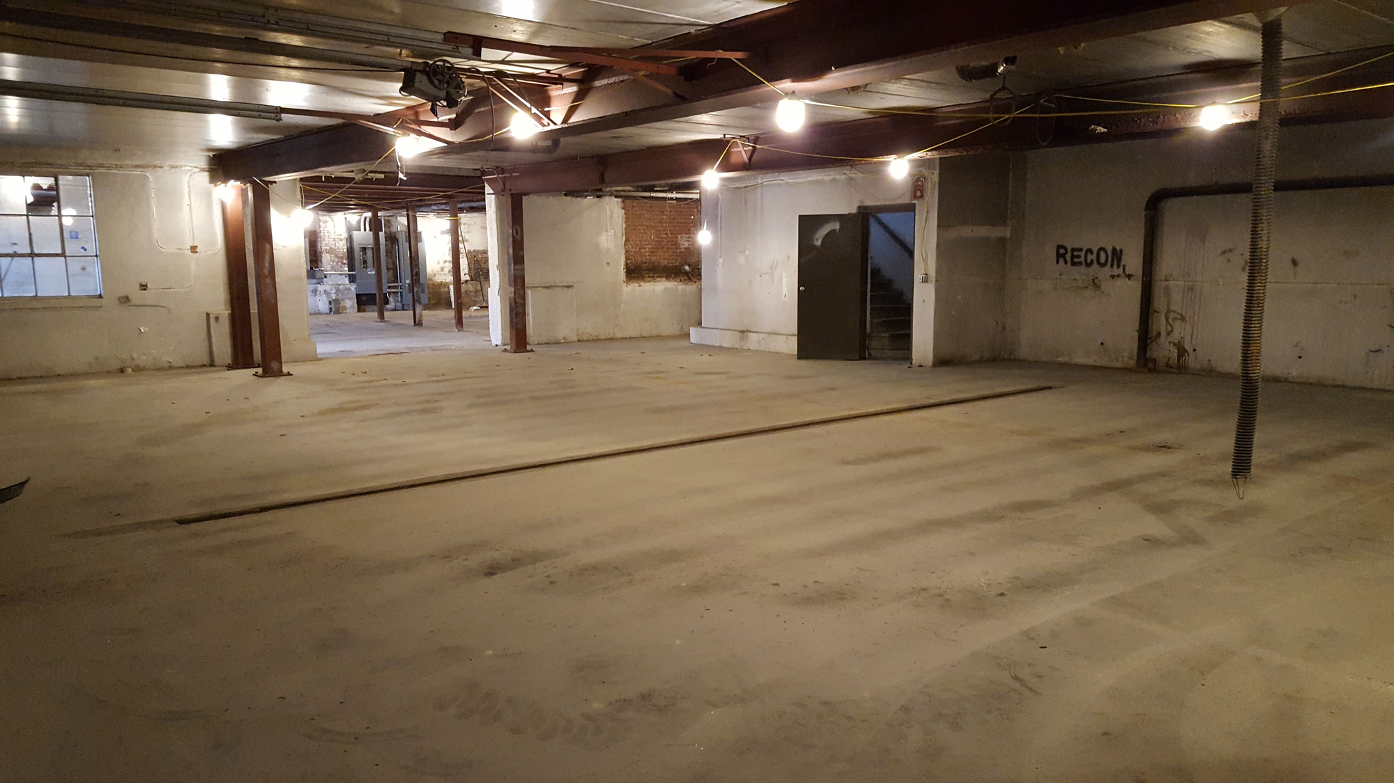
120 South Main Street

Slide 11
Police Station/Youth Center/Food Bank
Status
ARPA
Both the Colchester Police Department and Colchester Youth & Social Services have reviewed the size of the building and agree that it is more than adequate
They are willing to share the space and believe it would be a great opportunity for the Town
Updating the crosswalk will be cleared by the state. The Police will provide crossing guards for children going to the Youth Center after school.
Low traffic impact to the Town
15,000 square feet
ARPA Police Funding Request: $228K
ARPA Youth Center Funding Request: $800K

Slide 12
Funding Sources
120 South Main Street

Slide 13
Funding Sources
ARPA/BENDAS/SALE
Totals
ARPA Police Funding Request: $228K
ARPA Youth Center Funding Request: $800K
Bendas Police: $300K
Bendas Food Bank: $575K
Sale of Current Senior Center: $300K (already have multiple interested buyers)
ARPA: $1.028M
Bendas: $875
Senior Center Sale: $300K
Net: $2.103 M
Future Maintenance & Improvements
DCF Grant: $17,885
Police Special Duty: $100,000
  21-22: $60,435 (General Fund)
  22-23: $388,255 (General Fund)
  Net: $117,885 (New Special Fund)
  Burden to Taxpayer: $0

Slide 14
The FUTURE TO COME
120 South Main Street

Slide 15
The Future to Come
Option 1
Option 2
Option 3
Negotiations begin with the new buyer and town collaborates on renovations & design
Town Eventually Purchases 120 South Main Street
New Police Station, New Youth Center, New Food Bank, and New Parking Lot for the Town
Minimal impact to traffic
Town will have first option of refusal
Will negotiate price after we get hard numbers on building renovations
Negotiations begin with the new buyer and town collaborates on renovations & design
New Business Enters + Police Station or Youth Center/Food Bank. New Parking Lot still secured.
Purchase/Lease Part of Property Discussion
New Parking Lot for the Town
Town does nothing, developers bring in new businesses
Town misses out on two acres of prime real estate
Police Expansion in Town Hall, Youth Center looks at Senior Center
New Parking Lot access would be negotiated due additional tenants

Slide 16



Summary
These are exciting times for Colchester. Throughout this presentation we have reviewed a variety of potentials regarding a new parking lot, a new home for the Police, and a new venue for the Youth Center & Food Bank.
The Town is requesting an allocation of $228K of ARPA funds for Police Expansion and $800K of ARPA funds for a New Youth Center.

