Slide 1
Police Department
Colchester
FY24-25
Sgt. Zachary Cash #104

Slide 2
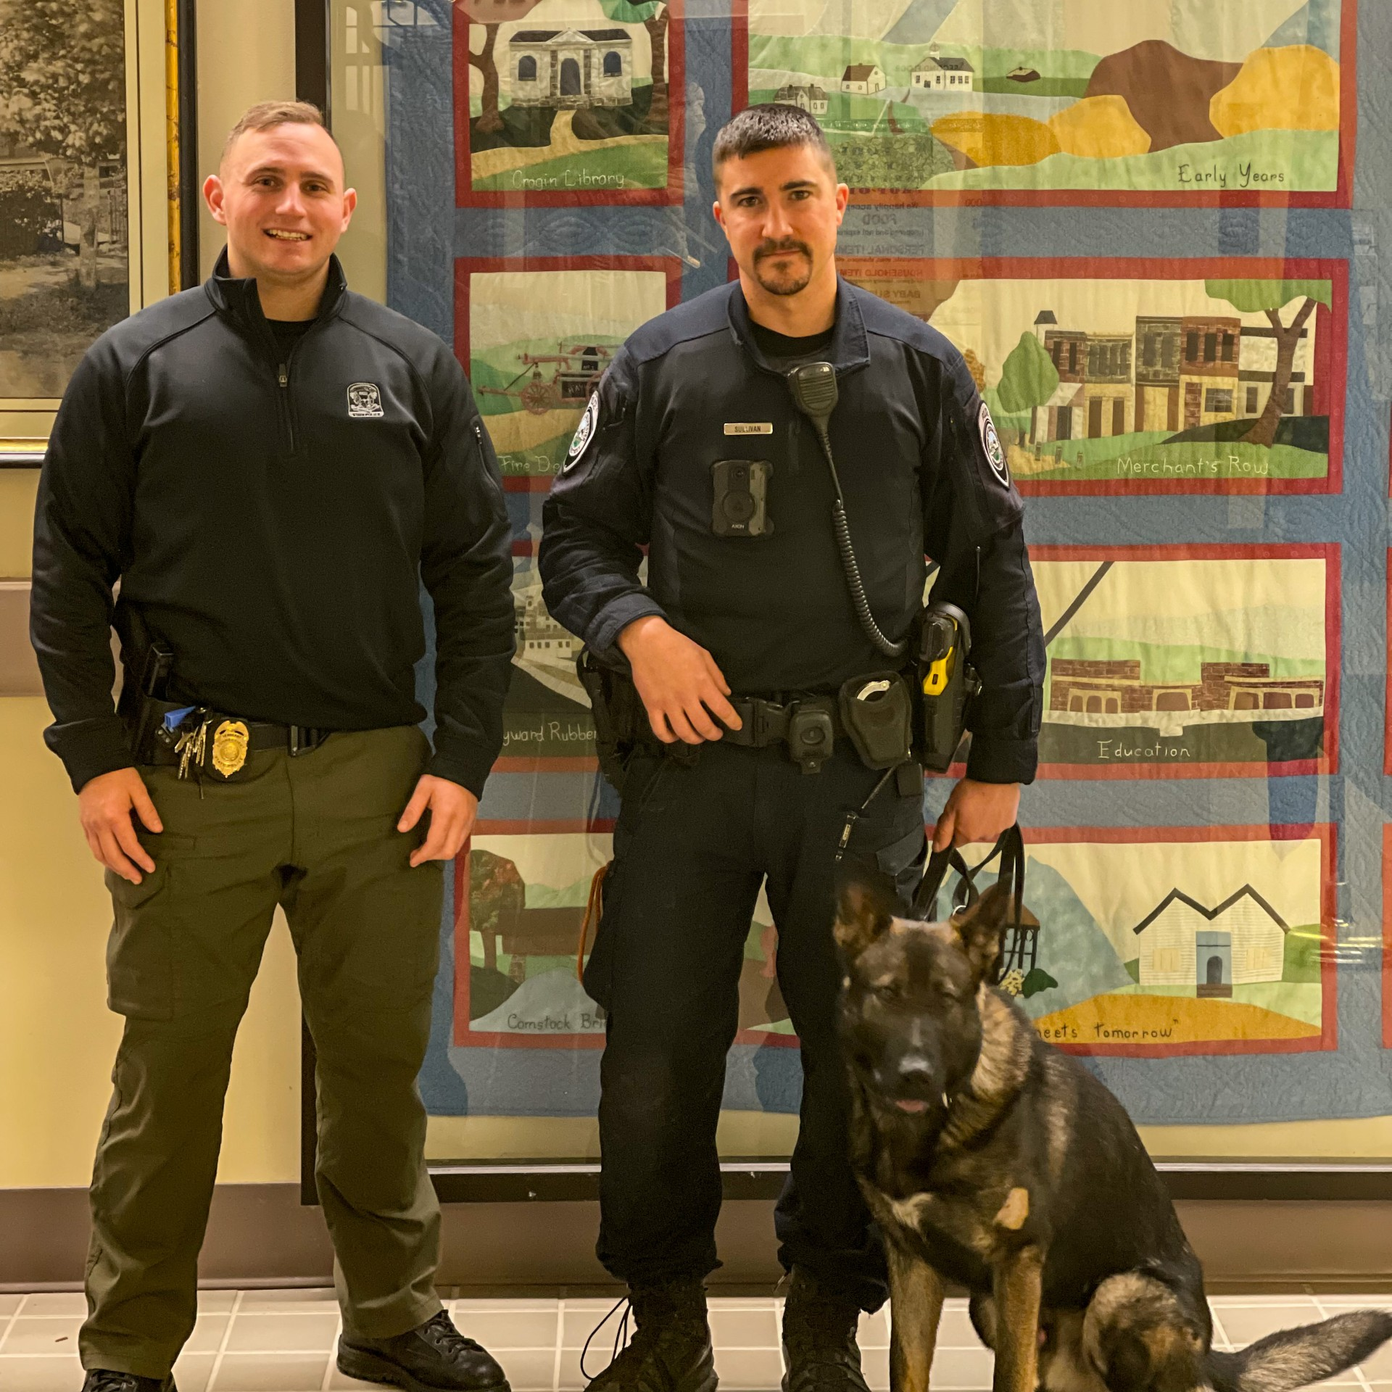
Staffing
10 Full Time Officers
8 Patrol Officers
1 Admin. Sergeant
1 School Resource Officer
-BOE Reimbursed
1 Resident State Trooper
1 Assistant to Dept. Head

Slide 3
Staffing
No Midnight Shift Coverage
2 Patrol Minimum, which goes to 1 during an “order-in”
No detectives, full time specialized units/services
Troop K does provide coverage, the “South” patrol (1 Trooper) covers Colchester, Salem, and East Haddam
10 Officers, but only 8 are part of patrol’s staffing

Slide 4
Town of Colchester Calls for Service (CFS) 2022 - 2024
Nexgen/PowerBI

Slide 5
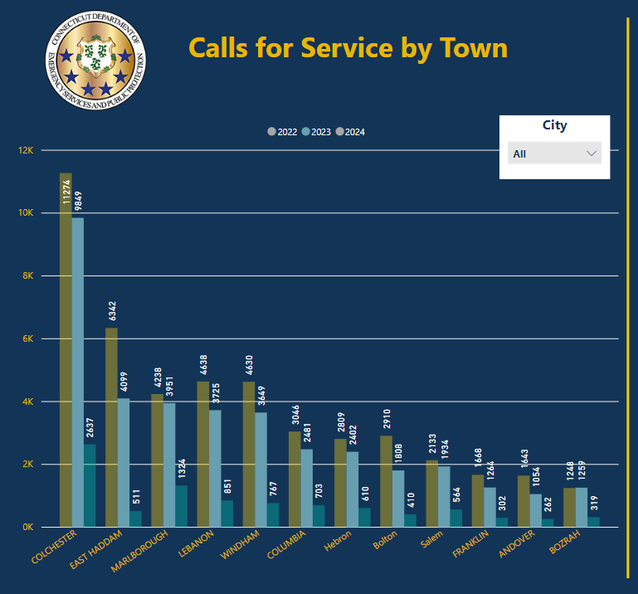

Slide 7
Majority of Accidents in Colchester

Slide 8
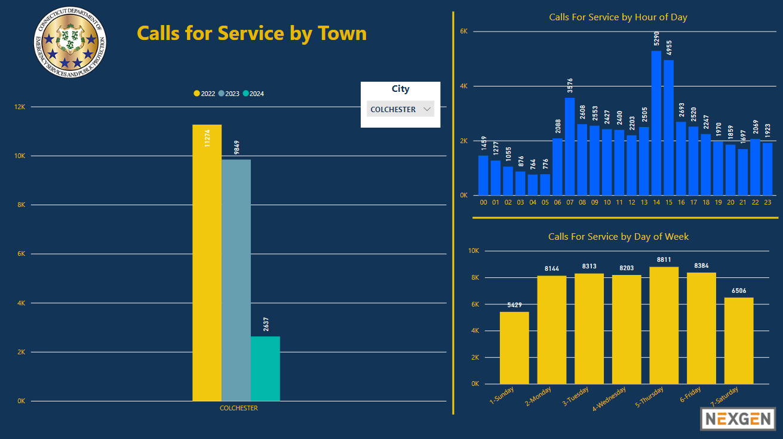
10,000 Calls for Service per Year

Slide 9
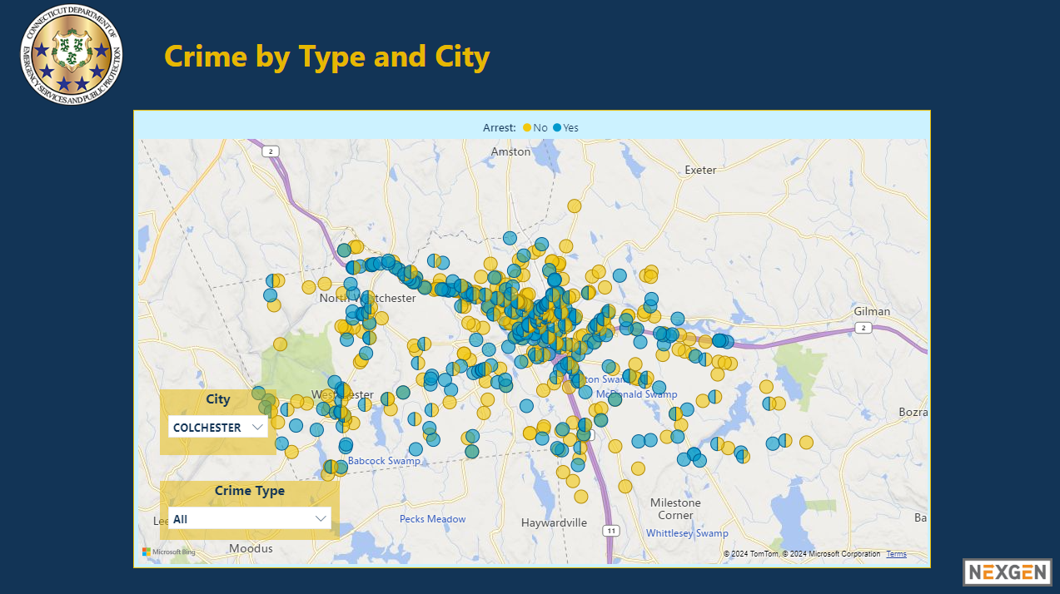
Crime Happens All Over Town

Slide 10
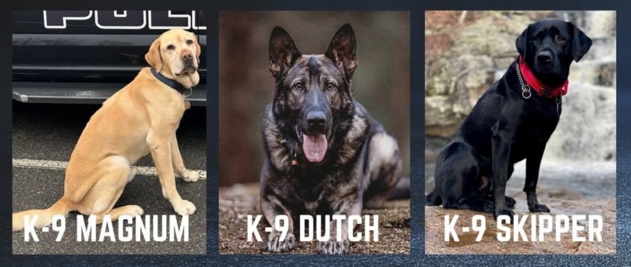
Goals for FY24-25
Replace Officer Vacancy
Facility Update
Highest Level of Policing
2024 Hiring Process had 22 Applicants
4 Applicants showed up for Physical Agility test
3 Applicants passed
Updates to Police Department
Expansion of operating space within Town Hall
Continue In-Service and Off-Site trainings
Provide Officers with high level, up to date equipment
Provide Colchester residents with the highest level of policing

Slide 11
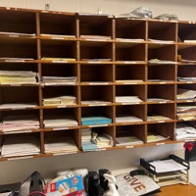
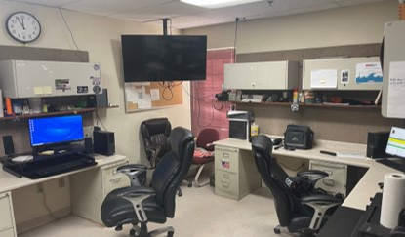
Report Room
Little space for workstations
Outdated computer systems
HVAC (Heating and Cooling) problems
No personal desk stations
Cluttered terminals for
Radio charging
Body camera uploading
Filing reports

Slide 12
Storage Space
Not enough room in weapons closet / armory
No secured filing area
No room for extra gear / equipment

Slide 13
Locker / Bathrooms
One bathroom
Office / Female locker room
Not enough room for Officers
Single gendered bathroom

Slide 14
Summary of Budget
Payroll, Overtime, Retirement
Majority of budget goes towards this
Minimum Staffing Patrol Overtime contribute most of overtime (2 patrol minimum days/eves), backfilling School Resource Officer.
Other Includes:
Uniforms, Ballistic Vests, Ammunition, Training Courses, Non-Contractual Equipment Repair, K9 Food.
Equipment Contracts Includes:
Axon (Body Cameras/TASERs, Data Storage), PowerDMS, POST and Law Enforcement Council dues, Resident Trooper contract.

Slide 15
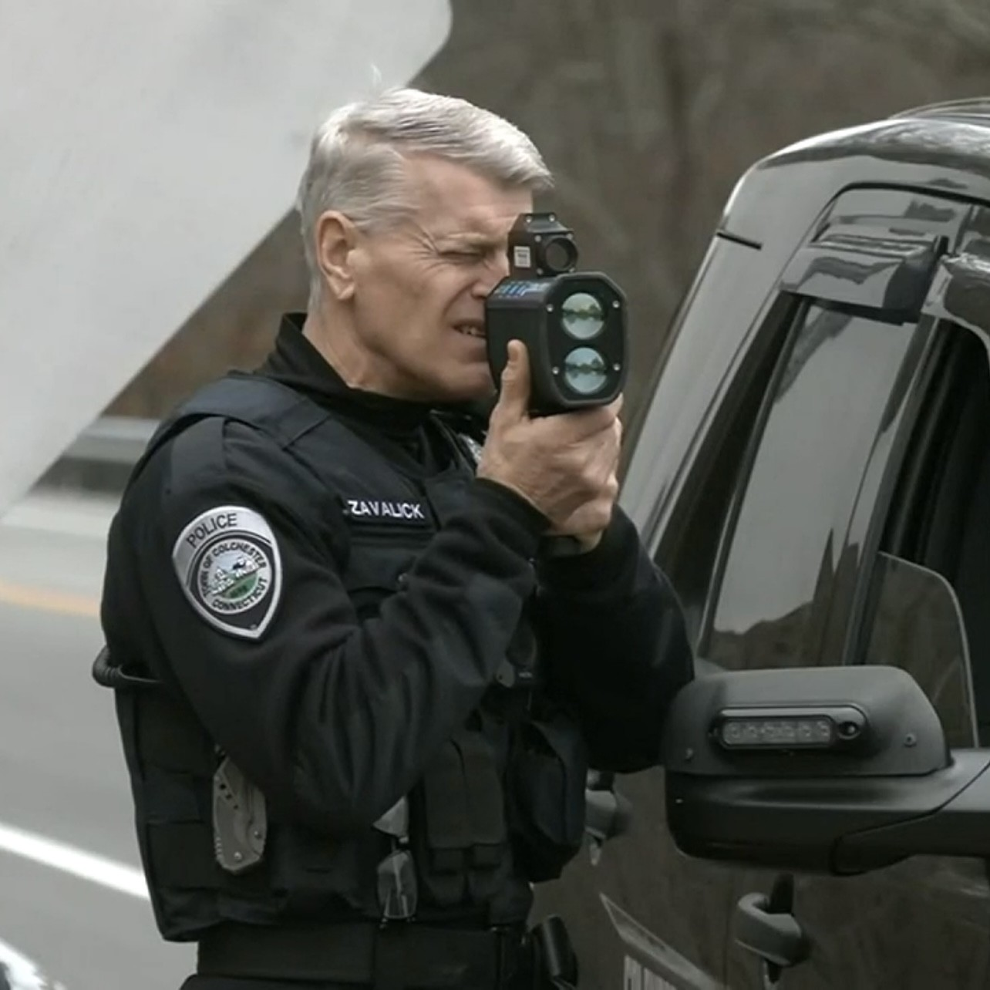
Grant Funding
COPS Grant
$152,000
PowerDMS and Axon (Portion)
File Management, Proofs, and other related equipment
High Risk Rural Roads
$60,000
Dedicated speed enforcement to Town maintained roadways
New Speed Lasers
ARPA Rural Roads
$50,000
Dedicated speed enforcement to all Town roadways
DWI Enforcement
$25,000
Evening hours
DWI patrols

Slide 16
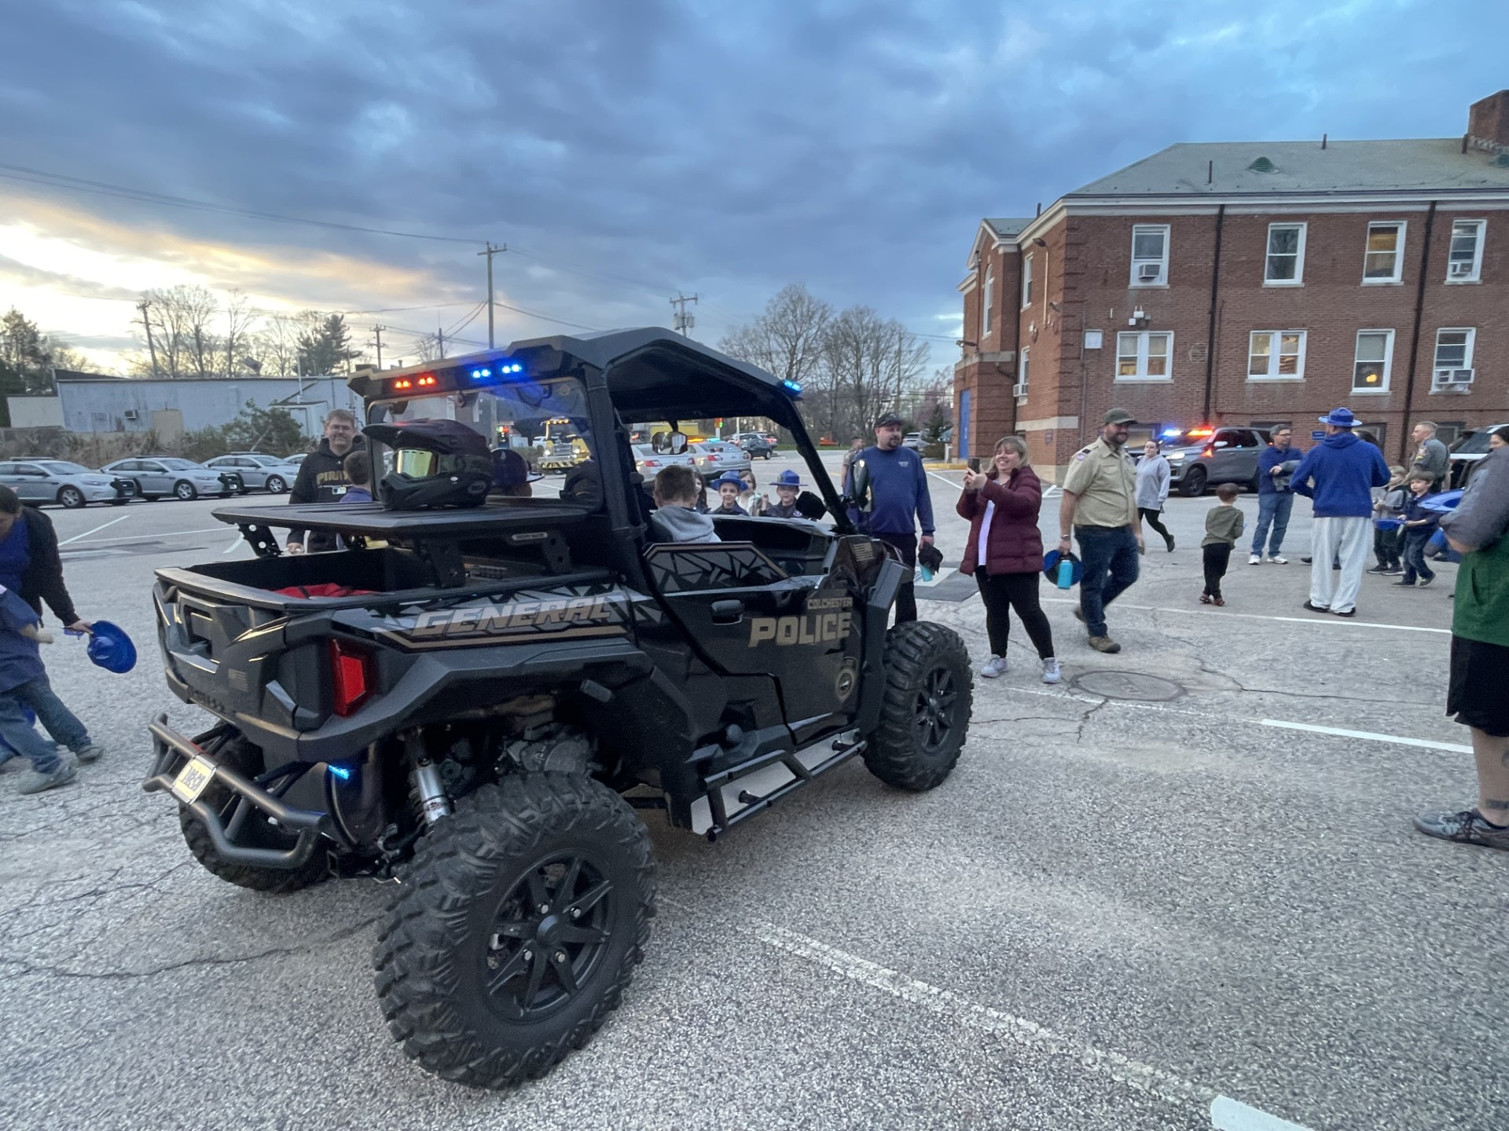
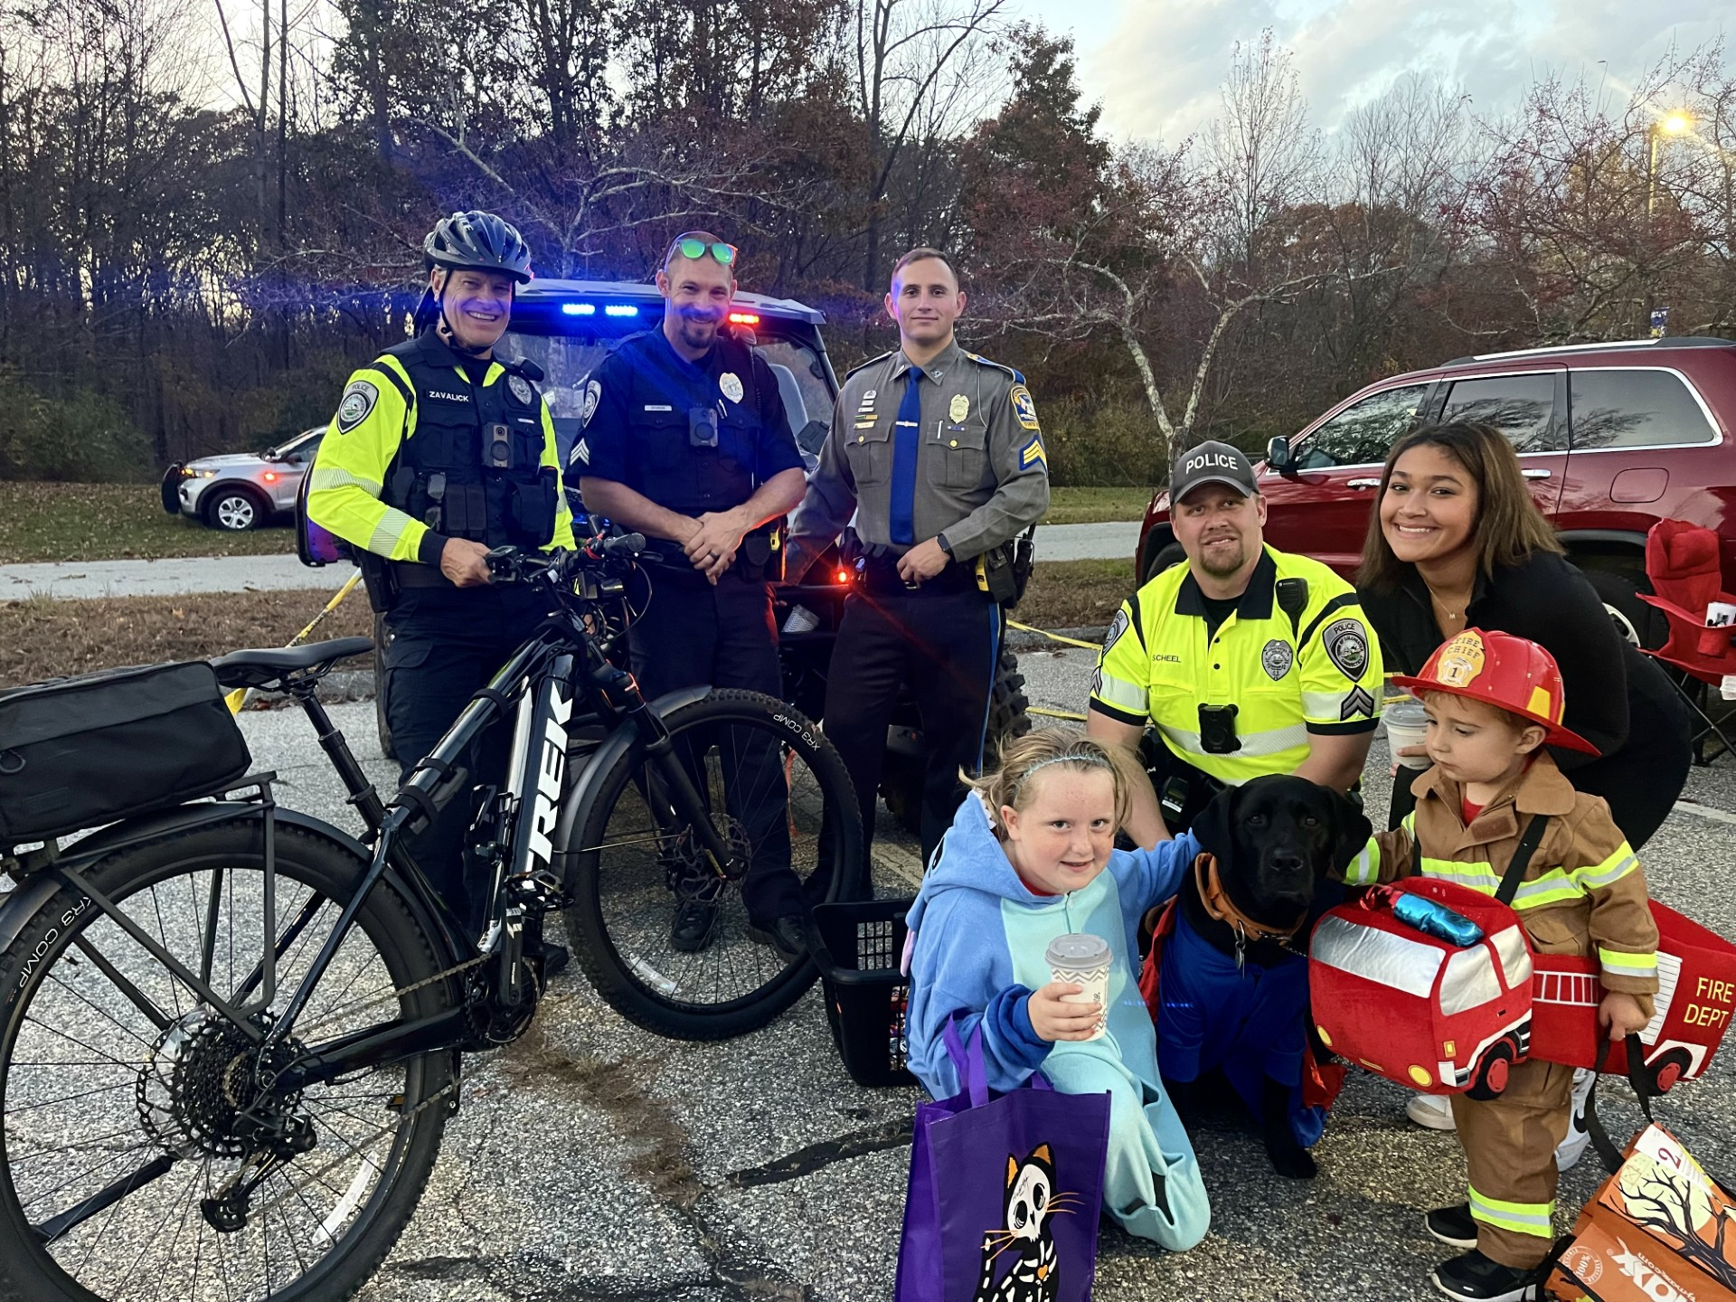
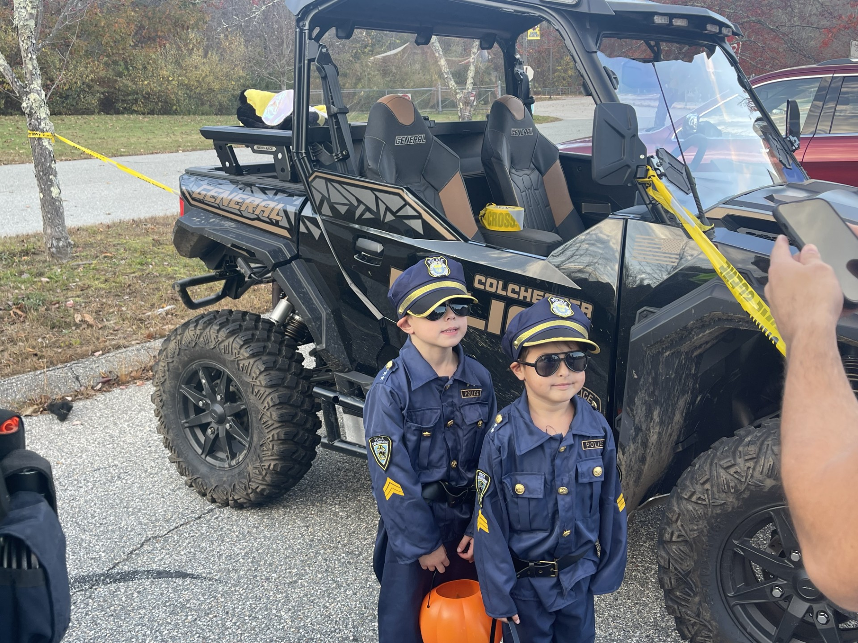
Budget Increases
Payroll
Contractual / Annual increases
FICA and Retirement
Updated calculation for 5 officers with pension
Overtime
Realistic representation of minimum staffing expenses
Telephone/Equipment Repairs
Increases in prices to cruiser MDT data, contractual software, state-mandated equipment

