Slide 1
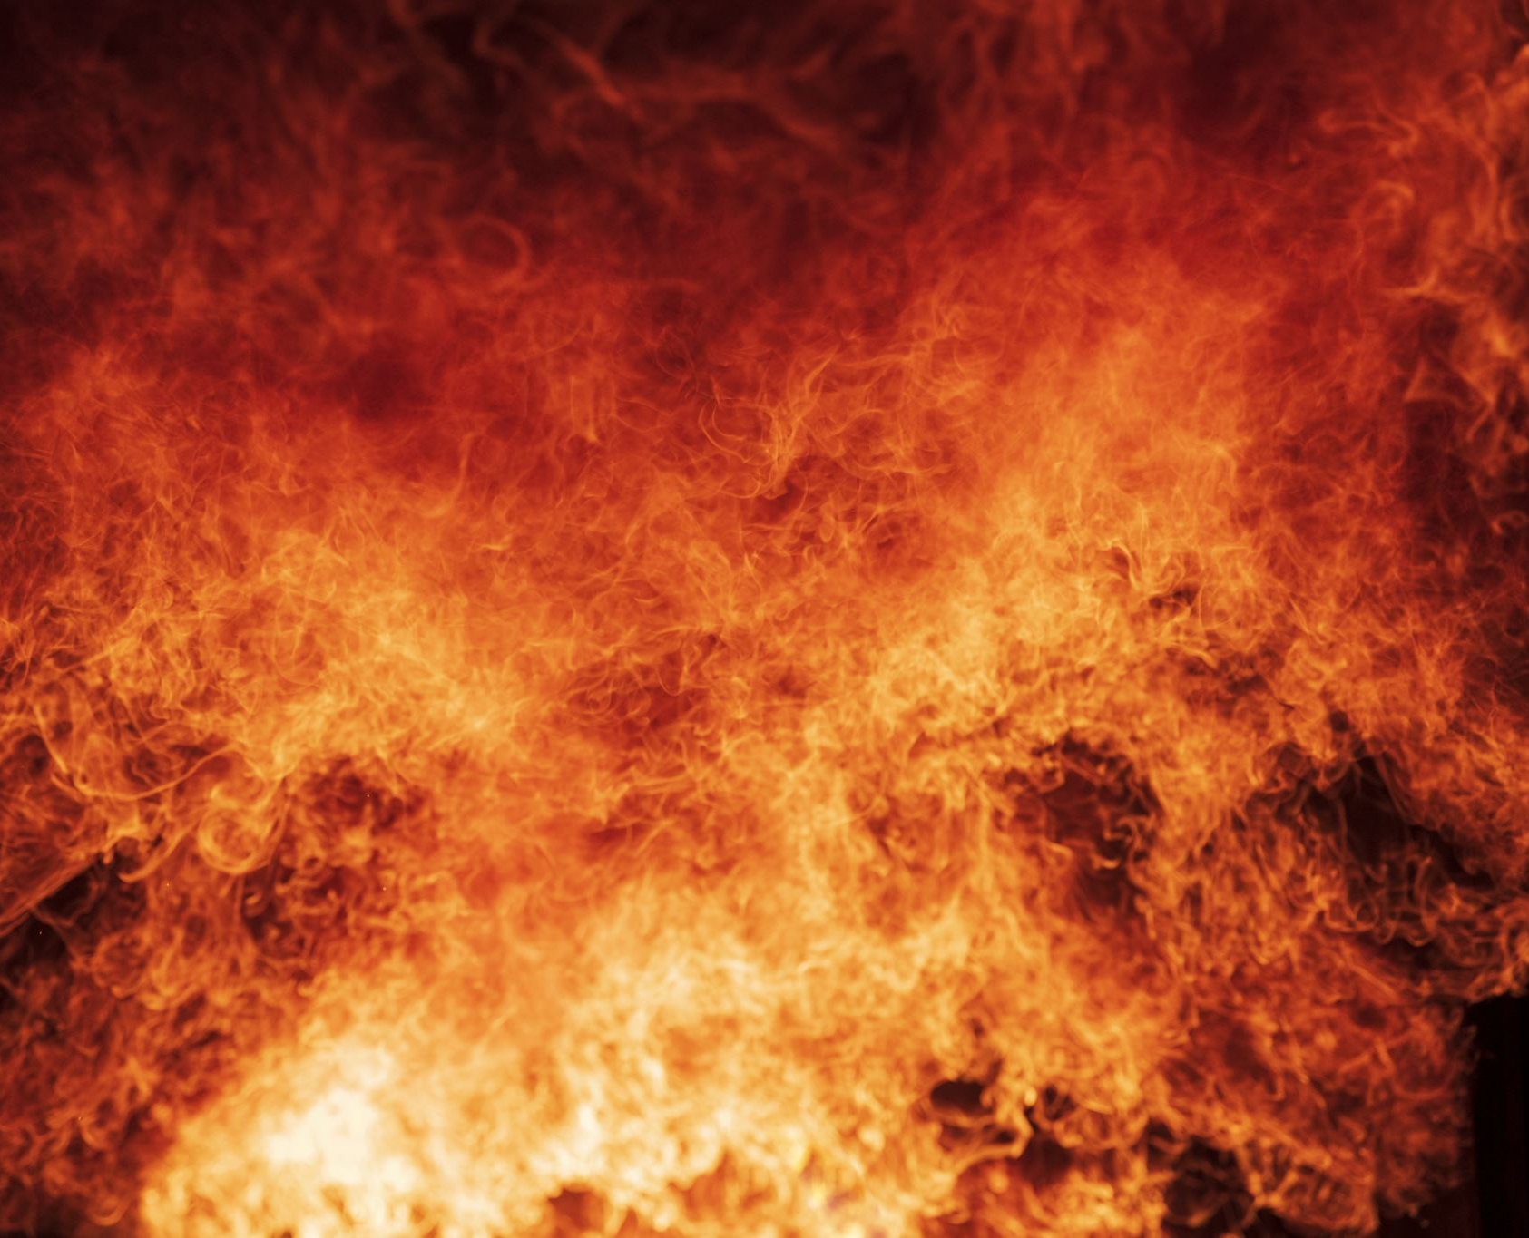
Colchester Fire & EMS FY25 Budget Request/Review
Fire Chief Steve Hoffmann
Deputy Fire Chief Brad Bernier

Slide 2
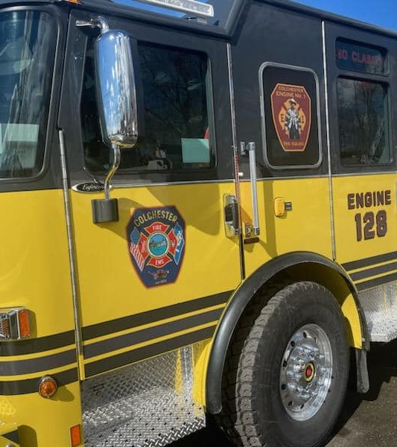
Colchester Fire & EMS – FY25 Budget
Mission Statement:
To provide quality fire, rescue and medical services for the Colchester community with pride, dedication & excellence.
Vision Statement:
We strive to be recognized as a progressive, innovative and cohesive public safety leader committed to providing exemplary service to the community.
Organizational/Core Values:
Service Excellence; Diversity; Integrity; Respect; Teamwork; Innovation

Slide 3
Colchester Fire & EMS – FY25 Budget
Department Staffing
Deputy Chief (Volunteer)
Volunteer Interior Firefighters – 30 (Personnel who are trained/cleared to conduct interior fire suppression activities. 21 are EMR or EMT certified to provide medical care)
Volunteer Support Firefighters – 7 (Personnel who are trained/cleared to provide exterior scene support. 3 are certified to provide medical care)
Volunteer Fire Police – 13 (Personnel who are trained to assist with traffic control at emergency incidents. 5 are certified to provide medical care)
Volunteer Emergency Medical Technicians – 13 (Personnel that can provide medical care at the basic life support level)
Fire/EMS Chief
Assistant Chief/Fire Marshal
Administrative Assistant Fire/EMS
Captain
Lieutenant (3)
Firefighter/Emergency Medical Technicians
(6) 24/7 coverage
Career Personnel = 13
Volunteer Personnel = 65
Total Staffing = 78
(As of 4/13/24)

Slide 4
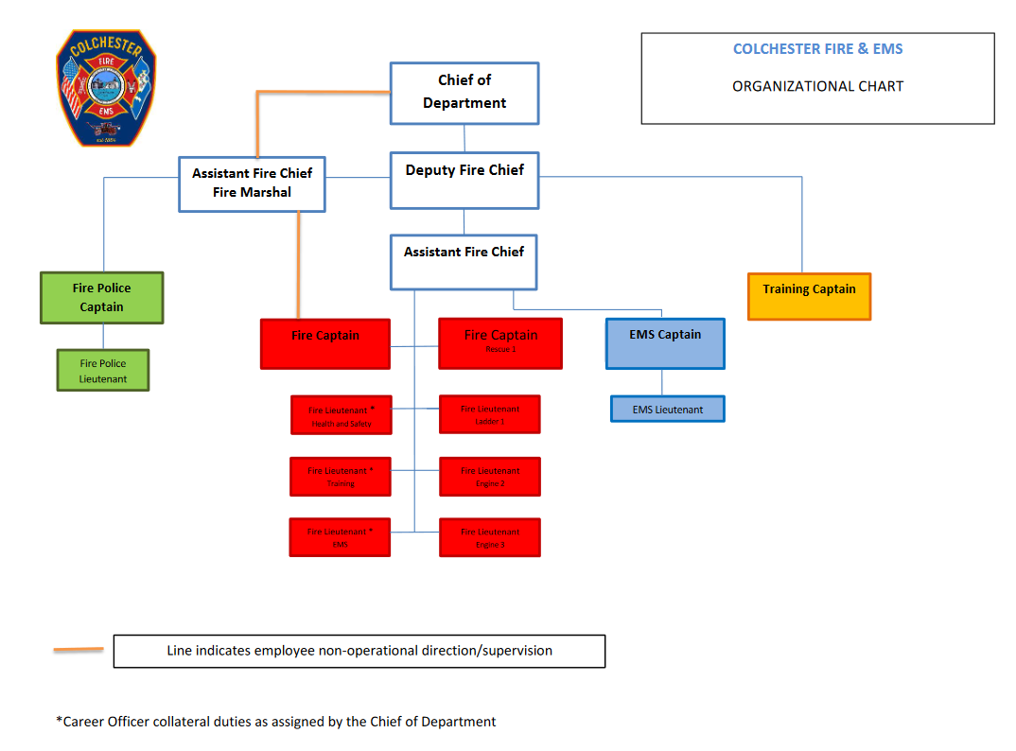
Colchester Fire & EMS – FY25 Budget

Slide 5
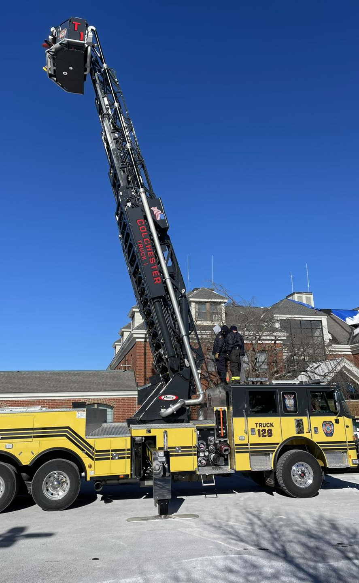
Colchester Fire & EMS – FY25 Budget
Accomplishments
Responded to 2,296 total calls for service – Fire/ EMS (Year 2023)
772 Fire related responses
1524 EMS related responses
Scheduled training/drill sessions (Year 2023) – 211
Provided support to Town sponsored events (ex. Santa Ride, 5K Resolution Run, Airline Trail ghost Run, COVID supply distributions, Colchester Day)
Awarded an AFG FEMA Grant to install Direct Source Diesel Exhaust Systems in both fire stations for health & Safety of personnel and community.
Upgraded obsolete technology with much needed portable radio communications for officers and on all apparatus for personnel operating at emergency incidents.
Updating of training requirements & policy to ensure skills & competencies are maintained while creating a quantity sufficient for a work/life balance to enhance volunteer personnel responses/retention.
Established clear expectations and standards; Established Training Companies to provide for mentorship and a better span of control off the fire ground

Slide 6
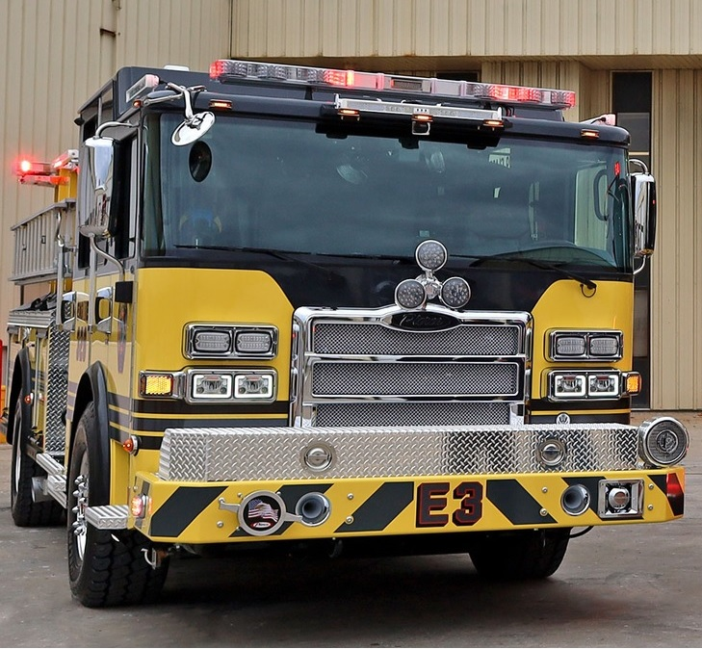
Colchester Fire & EMS – FY25 Budget
Accomplishments
Develop a Succession Plan to provide a roadmap for personnel interested in advancing in the department and taking on leadership roles.
Rebranding of the organization to reflect the community and provide for a collaborative environment for all stakeholders, both internal and external, that is all-inclusive and attractive for personnel to want to be a part of and join.
Establishment of a town ordinance creating Colchester Fire & EMS as a municipal fire department in the Town of Colchester.
Preplanning of target hazards throughout town enhance familiarization, pertinent information collection, reference of significant info for a response if needed.
Provided 4 Community CPR & Stop the Bleed offerings FREE to residents at Fire HQ; 30 residents were trained.
11 Fire Safety & Education Events provided to the community with 699 contacts in attendance at the various offerings.
Smoke Alarm & Fire prevention CRR event held at Westchester Village installing over 44 smoke alarms in over 24 homes.

Slide 7
Colchester Fire & EMS – FY25 Budget
Organizational Rebrand
Creation of one identity/one name that represents the Department that provides emergency service to Colchester and neighboring communities
Referred to too many names creating an identity issue which created a cultural issue within the organization
Differentiation between the CHVFC and the Department needed to be established
Colchester Fire & EMS was established through ordinance in July 2023
This process was started in January 2023 and took months of meetings and discussions to where we are today
The creation of an organization that was inclusive of all the partners that assist in providing emergency services to the community
Colchester Hayward Volunteer Fire Company, International Association of Firefighter Union, Colchester Hayward Auxiliary and the Cadets all support and provide success to Colchester Fire & EMS

Slide 8
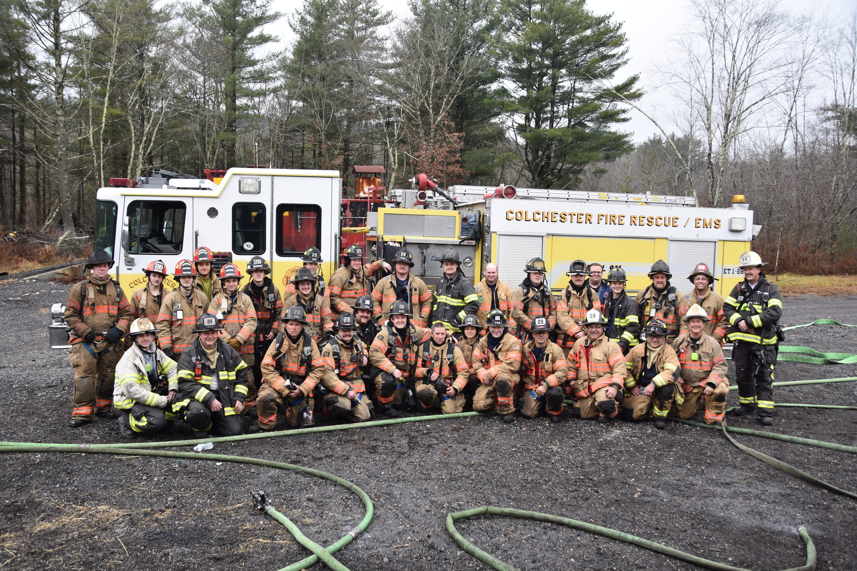
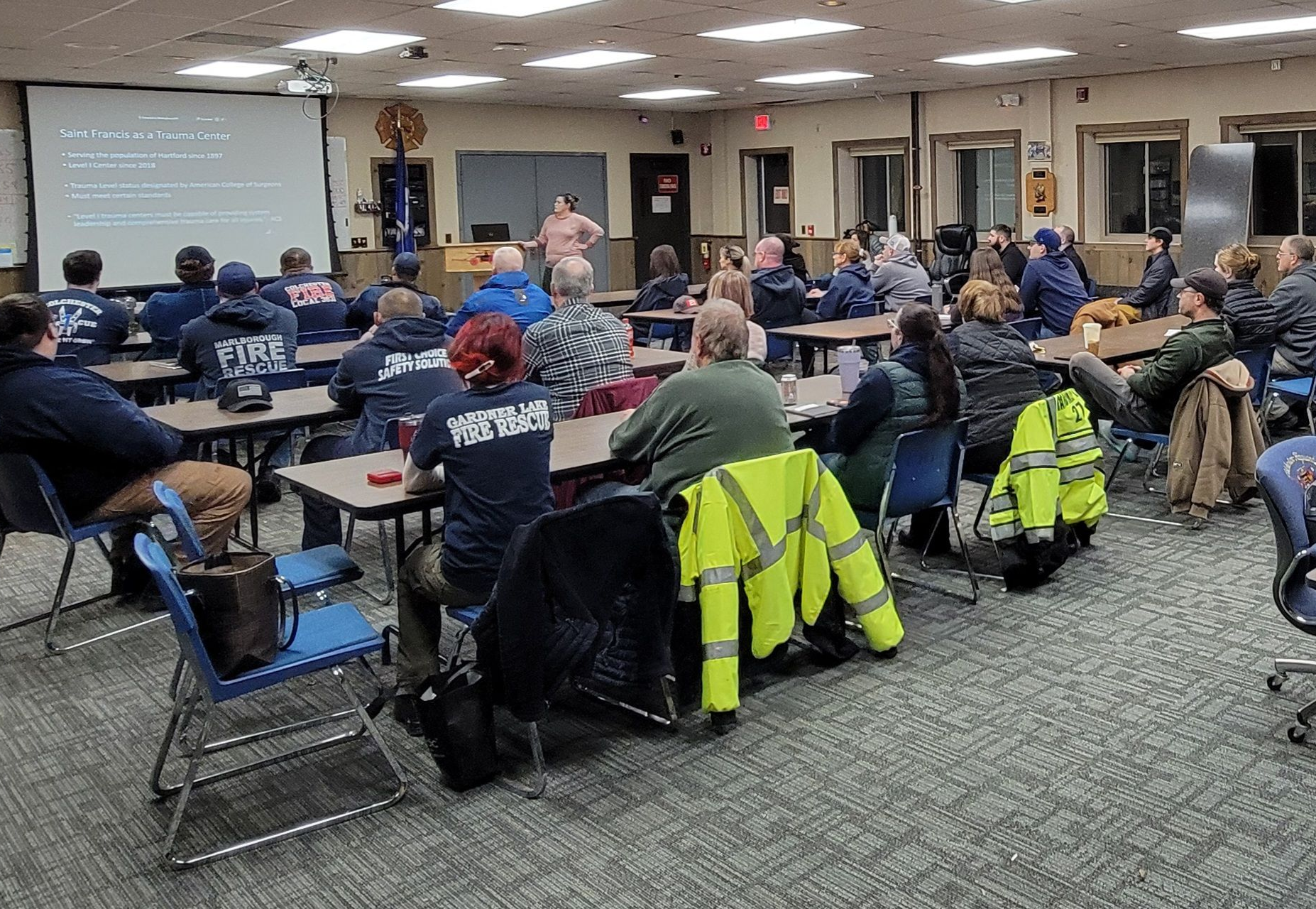
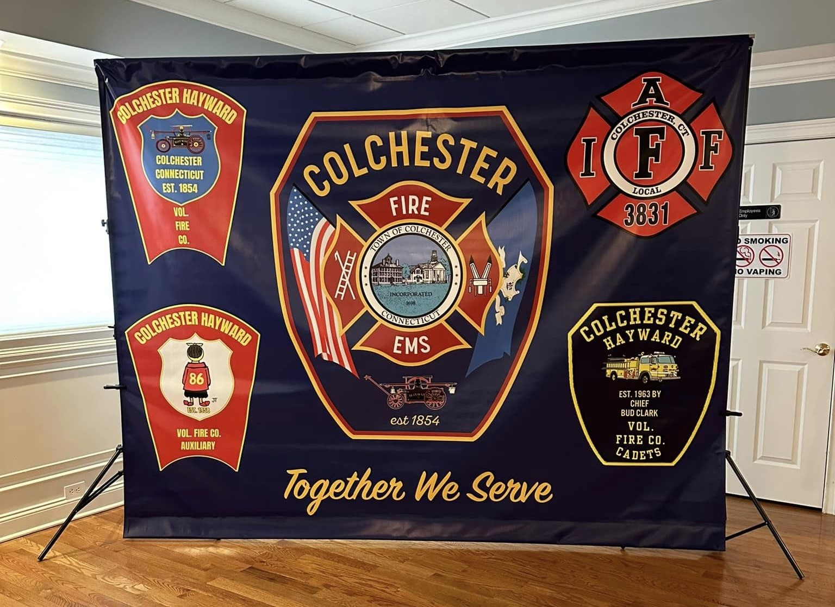
“Together We Serve”

Slide 9
Colchester Fire & EMS – FY25 Budget
Fire Responses
Average Turnout for Volunteers
for Incidents in
2023 = 5-6 overall avg.
(Higher turnout for high risk/low frequency incidents)
ISO (Insurance Service Office) references a 1/3 factor for career personnel and volunteer personnel
1 Career = 3 Volunteer
*Colchester maintains a Class 4 ISO Rating*

Slide 10
Colchester Fire & EMS – FY25 Budget
Average Overall Response Times – EMS
8:57 Minutes (Turnout & Travel Time)
Colchester LEMSP Performance Standard = Priority 1/7 Min; Priority 2/9 Min
Average Overall Response Times – Fire
7:50 Minutes (Turnout & Travel Time)
Response time meets NFPA 1720 – 2020 Edition for Rural Community (<500 per sq mile Population for rural communities)

Slide 11
Colchester Fire & EMS – FY25 Budget
EMS Responses
Time of Day
Day of Week

Slide 12
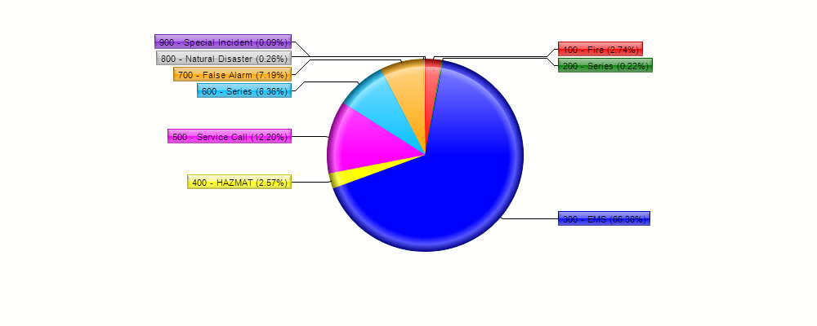
Colchester Fire & EMS – FY25 Budget
2023 Percentage Breakdown:
Top 3 Incident Types:
EMS
Service Calls
False Alarms
(500) Service Calls = 280
(554) Lift Assists = 190 (67% of the 12.20% call percentage)
(700) False Alarms = 165 (CO, Fire Alarm, Smoke Detectors, System Malfunction)

Slide 13
Colchester Fire & EMS – FY25 Budget
Measures (January 1 – December 31, 2023)
Total Calls = 2,296
Total Personnel Hours – Calls/Emergency = 15,888
Training Personnel Hours = 3,700
2023 2022 2021 2020 2019 2018 2017
Fire Marshal Inspections 716 804 307 102* 786 614 572
FM Violations Issued 120 176 172 76* 327 249 374
Fire Calls: 420** 336** 59 64 44 57 48
Rescue/Medical Calls: 1529 1878 1630 1219 1334 1455 1275
Hazmat/Elec. 64 63 50 83 45 78 65
Other Calls (Service): 280 171 190 342 261 418 336
Mutual Aid (given/received) 240/165 202/74 328 293 340 347 210
* Inspection numbers reflect FMO having limited access to residential properties due to Covid-19 pandemic. These inspections will need to be made up during the upcoming year.
** 2023 Includes false alarms (165), Good Intent (192) as well as fire calls

Slide 14
Colchester Fire & EMS – FY25 Budget
2024 – 2025 Objectives
Continued focus on volunteer recruitment and retention; Completion of a study for development of a Strategic Master Plan to focus on future facility, equipment and staffing needs for Colchester Fire & EMS.
Enhancing and improving the volunteer personnel onboarding process and probationary process to provide for better retention
Addition of 2 career Firefighter/EMTs to provide for 3 career firefighter/EMTs on each of the four rotating shifts, 24/7.
Continue to provide quality training at a quantity that ensures skills and competencies are maintained, but not to excessively utilize personnel time creating a manageable work/life balance.
Provide training and development on the leadership & management for the fire department utilizing in-house instructors and outside vendors.
Develop a partnership with the Colchester School system to provide an in-school program to provide exposure to fire & EMS services to high school students.
Continue development of the Community Risk Reduction Program to reduce risk within the community and decrease calls for service; Establish a Fall Prevention Program
Continually seek Federal Grant Opportunities to support Colchester Fire & EMS Mission and needs.
Offer quarterly Community CPR free to the public; Offer Fire Safety Training and education to the community.

Slide 15
Colchester Fire & EMS – FY25 Budget
2024-2025 Objectives
Enhance communication capabilities by aligning with the state radio system for interoperability with town departments and mutual aid partners.
Creation and maintenance of procedures and policies that align with the department mission to ensure continuity and uniformity throughout the organization.
Creation of a Regional Confined Space Rescue Team with our mutual aid partners from Hebron FD & East Hampton FD.
Quarterly and annual evaluation reviews of department statistics to ensure services provided are meeting the communities’ expectations as well as industrial standards.
Create and maintain a fiscally responsible operation budget to assist in the growing needs of the fire department; creation of a seven-year capital plan the illustrates and establishes improvement needs of facilities, apparatus and equipment.
Review and update the current agreement with the Colchester Hayward Volunteer Fire Company to reflect the current needs of the department and town with relation to services, reimbursements, recruitment/retention, etc.
A 3rd ambulance for the apparatus fleet to ensure two ambulances are always in services to accommodate the current ambulances being “re-furbished” and ultimately provide a 3rd ambulance for responses and maintenance rotation

Slide 16
Colchester Fire & EMS – FY25 Budget
Budget Breakdown
Regular Payroll/Salary
Contractual Increases (renegotiated after adoption of FY24 budget, 9/8/2023)
Holiday Pay not calculated into the salaries
Contract Temp/Occasional
Deputy Chief Stipend (Removed from Regular Payroll) - $7,800 stipend
Ambulance Staffing increased due to more volunteers signing up for program and taking more shifts - $15,000 to $20,000
1,460 Volunteer 6-hour ambulance shifts a year
799 6-hour shifts covered by volunteers (626 shifts in 2022)
Creation of 3 career officer positions
Improper allocation for the 24-hour work weeks in the 24/72 hour shift rotation
Increase of $129,810

Slide 17
Colchester Fire & EMS – FY25 Budget
Gear
Reduced by 1 set of gear to accommodate vendor increases
Professional Services (Comstar – Ambulance Billing)
Ambulance revenue drives this line item, Cost for processing Ambulance billing
Increase in Ambulance Revenue = Increase in Professional Services
2023 Ambulance revenue - $721,017.56
2024 Ambulance revenue (Mar 2024) - $472,121.10
$6,424 per FULL set of gear = $44,968 for 7 sets
7.6% increase over all the PPE items
($2,792) reduction in line item with removal of 1 set
Increase of $4,500 to accommodate revenue increase for FY25

Slide 18
Colchester Fire & EMS – FY25 Budget
Service Contracts
Dispatch (QV) – Covers ALL 911 calls for Colchester (Fire, Police, EMS)
Also takes routine calls for Public Works
ALL 911 calls come through QV, transferred for State Police for police matters/incidents
Physicals & Testing
Increased due to the testing required for the 3 categories of personnel
Interior Firefighters - $510 per
Exterior Firefighters - $262 per
Support Firefighters - $202 per
Cancer legislation requirements – Firefighters are 9% more likely to be diagnosed with cancer and 14% more likely to die of cancer then the general public – FF Cancer Network
EMS Supplies
AED Inspections and replacement supplies provided by Colchester Fire & EMS for town facilities/buildings
PTSD Legislation/Workers Comp – 20% of firefighters/EMS meet criteria for PTSD at some point in their careers, 6.8% lifetime risk for general public - August 2016 Journal of Occupational Health Psychology
Total $32,000 = Increase $3,500
Increase to $15,000 from $6,000 ($10,500 in FY22 & FY23)
Processed 4,112 911 calls in 2023; Unknown how many routine calls

Slide 19
Colchester Fire & EMS – FY25 Budget
Apparatus Repairs/Maintenance
Received 4 new fire apparatus; slated to receive a 5th in July/August
Apparatus are on a 1- year warranty with Firematic, providing opportunity for a decrease
Fire Hose
Decreased due to change in replacement schedule
NFPA 1961 required fire hose be replaced on a schedule, not based on a 10-year life cycle
ALL hose is tested annually, if it fails it is removed from service and replaced
Documentation is maintained for the life of the hose, utilized for ISO for 5-year updates
($20,000) = $30,000
($3,000) = $3,000 ($6,000 in FY24)

Slide 20
Colchester Fire & EMS – FY25 Budget
Regular Payroll & Overtime
FY24 Overages
24-hour coverage was being provided from July until the signing of the new contract, as has been the case since late 2021
Creation of 3 additional career officer positions; The Deputy Chief position “sunsetted” out of the new contract
2 new career firefighters were hired to support the transition to 24/7 staffing coverage, driven largely by increase in EMS calls and decline in volunteer turnout.
1 firefighter was on administrative leave from the beginning of the budget year till 11/23, resulted in needed coverage on shifts
Contract updated on 9/8/23 with pay increases; affects overtime rates
Contracted call back requirements
19 structure fires mutual aid
Number of structure fires and reports of structure fires in town
Vacation, Sick, Personal time being filled as per the contract
Contract brought minimum staffing requirements after 9/8/23

Slide 21
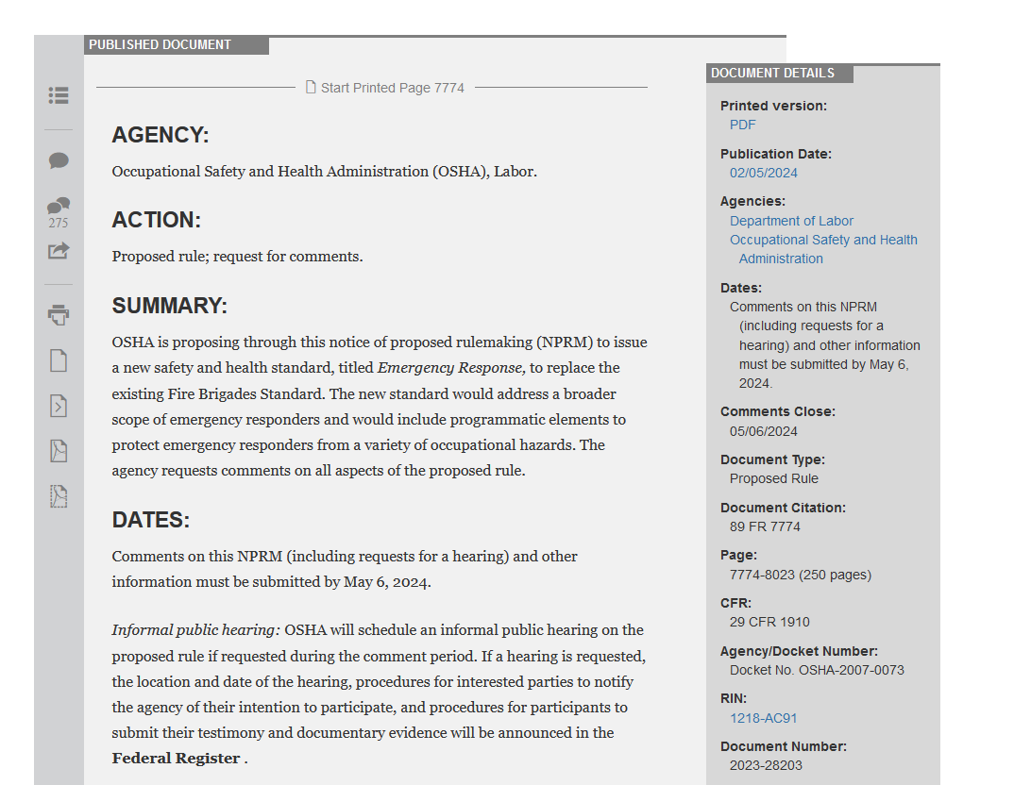
Colchester Fire & EMS – FY25 Budget
OSHA 1910.156 – Fire Brigades to Emergency Response
Training
Fire Brigade Standard to Emergency Response Standard
Update has not completed since 1980
Direct reference to NFPA standards pulling them into the legal mandate
Training, Fitness, Facilities, operations, etc
Cost increases are expected for implementation to meet this document, if adopted as written
Further About the Rule
The focus of the proposed Emergency Response rule is to provide basic workplace protections for workers who respond to emergencies as part of their regularly assigned duties. Notably, the scope of protected workers under the proposed rule would be expanded to include workers who provide emergency medical service and technical search and rescue.

Slide 22
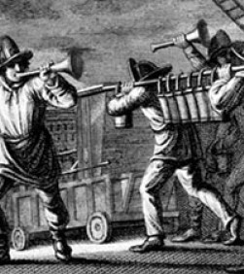
Colchester Fire & EMS – FY25 Budget
Volunteer Servitude of the Modern Fire Service
Firefighting is perhaps one of the oldest and most well-established institutions in what is now the United States of America.
For centuries governments have relied on an expectation that so long as each and every member feels a passion and calling for the craft, those responsible for the prioritization of fire service funding will continue to enjoy a service provided at no cost.
They continue to demand this today, ignoring the higher expectations and expanding skillsets demanded of their firefighters.
Volunteers are being overutilized in the interest of cost-effectiveness
Volunteerism is declining across the country at an alarming rate.
The predominant consensus is that this is a direct result of inflating costs of living coupled with the sheer volume of training required to maintain certification as a firefighter.
Concurrently, communities hoping to hold onto this essential service being provided at no or an extremely low financial cost
Today, the expectation of free labor in our industry is not only praised, but expected, demanded, and even defended by the very people who are affected the most. Unfortunately, in our desperation to preserve the historic institution of volunteer firefighting, ideals have remained unchanged while membership has steadily dwindled.
Need to support incentives and programs that entice volunteer recruitment & ultimately their retention to the fire service.

Slide 23
Colchester Fire & EMS – FY25 Budget
JOIN Today
Volunteers needed

Slide 24
Colchester Fire & EMS – FY25 Budget
QUESTIONS?

