Slide 1
FY 2025-2026
Senior Services Department
Presentation to the Board of Finance
Patty Watts
Director of Senior Services

Slide 2
What Do Senior Centers Do?
“Senior centers serve as a gateway to the nation’s aging network—connecting older adults to vital community services that can help them stay healthy and independent.”
National Council on Aging

Slide 3
Meals & Nutrition
Information & Referral
Transportation
Services
Health, Fitness & Wellness Programs
Meaningful Volunteer Opportunities
Employment Assistance
Public Benefits Counseling
Social & Recreational Activities
Senior Center

Slide 4


Meals & Nutrition
Meal Deliveries for Homebound Seniors
Senior Nutrition Program

Slide 5
Information & Referral
Every city and town in CT has a Municipal Agent for the Elderly who assists town residents ages 60+ by providing information and referrals to local, state, and federal services and benefit programs including but not limited to:
Medicare
Medicaid
SNAP (Food Stamps)
Social Security
Protective Services for the Elderly
Legal Services
Adult Day Care
Housing
Transportation
Local Senior/Community Groups, and more

Slide 6
Transportation Services
The Colchester Senior Center provides In-Town transportation to Colchester residents to destinations within town limits
We also provide Out-of-Town medical transportation within a 40-mile radius of Colchester, again for Colchester residents only
We have 3 wheelchair-lift equipped mini-buses and a minivan in our fleet, and a passenger van on order through the Section 5310 grant.
We serve adults ages 60+ and those 18+ with a disability

Slide 7
Social & Recreational Activities
Arts & Crafts
Billiards
Cards & Games
Choral Group
Computer & Technology Classes
Educational Programs
Fine Arts Instruction
Food Demos
Health Screenings
Intergenerational
Life-Long Learning
Movie Screenings
Special Events
Support Groups
Trips
Walking Group
Zumba
over 200 programs every month

Slide 8
Health, Fitness & Wellness Programs
Health Screenings: Blood Pressure Clinics, Vision & Hearing Screenings, Depression Screenings, Community Nursing Programs
Vaccination Clinics: Access for seasonal vaccines including Flu Shots and Covid Boosters
Collaborative programming with Chatham Health District
Evidence-Based Programs: Chronic Disease Self-Management (CDSMP) Education & Falls Prevention
A variety of Fitness Classes: Aerobics, Tai Chi, Yoga, Seated Exercises, etc.
New Fitness Center provides access for seniors to work out independently on state-of-the-art equipment. 75 people have been through the Fitness Center Orientation since opening in February 2025.
Health & Wellness Fairs for the community

Slide 9
Access to Public Benefits
Help with Medicare: CHOICES Counseling, New to Medicare & Open Enrollment
Benefits Check-Up
SNAP Applications (formerly Food Stamps)
Energy Assistance Program* (seasonally)
Renters’ Rebate Program* (seasonally)
AARP Tax Aide Services (seasonally)
Senior Farmer’s Market Vouchers (seasonally)

Slide 10
Meaningful Volunteer Opportunities
Work on your own terms and to suit your schedule.
Most senior centers offer opportunities for seniors to serve in an area of talent/strength.
Add productivity and community engagement for retirees looking for “something to do.”
We currently have over 100 volunteers serving in a variety of areas.

Slide 11
Awards & Distinctions
The Colchester Senior Center has been designated as a Community Focal Point for Senior Services & Programs by our local Agency on Aging
We were the recipient of a National Institute of Senior Centers (NISC) Program of Excellence Award in 2016 (Honorable Mention) & 2024 (Category Winner)!

Slide 12
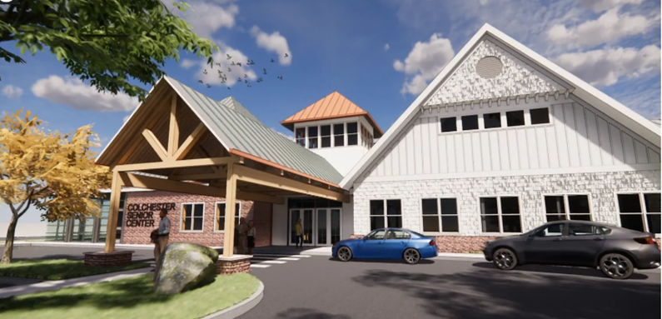
NEW Senior Center at
15 Louis Lane

Slide 13
Why Did We Need a New Center?
The new building addresses all of the issues with our former building including available program space, parking considerations, facility conditions and universal accessibility.
Membership has grown by 350 new members since the Grand Opening in December 2024 and now stands at 2,289.
New amenities are drawing in new members: Fitness Center, Billiard Table, increased program capacity.

Slide 14
Service Statistics Over 3 Years
 | 2024 | 2023 | 2022
Membership Totals | 2,046 | 1,770 | 1,640
Annual Count | 951 | 826 | 781
Total Clients Served | 35,388 | 30,800 | 25,617
Program Sessions | 1,767 | 1,821 | 1,694
Non-Medical Transportation | 7,990 | 7,034 | 6,547
Medical Transportation | 2,275 | 2,329 | 2,610
Mileage for In-Town Rides | 29,288 | 26,845 | 25,185
Information and Referrals | 10,353 | 10,225 | 10,211
Making Memories Program | 3,894 | 2,266 | 2,436
Volunteer Hours | 5,386 | 4,593 | 3,672
Attendees for Travel Opportunities | 337 | 348 | 356
Meals on Wheels Delivered | 7,894 | 7,815 | 6,324
Café Meals Served | 4,765 | 4,420 | 4,420

Slide 15
Future Needs
We are serving an average of 170 people per day. That is an increase of 43 more people per day over 2024—an extra 215 per week, and 925 people per month.
In the future, we will need to our staffing to expand to meet the seniors’ needs, particularly an In-Town Driver as rides/mileage has grown and a part-time Program Assistant to be able to grow programming to meet the demand for evening/weekend programs.
Except for a 20 hr./week Medical Driver, staffing has not increased despite our membership growth of 312%. Current staff are at their capacity.
We cannot continue to grow without also strategically expanding staffing.

Slide 16
Budget Impact for FY 2026
Contractually obligated labor increases
Operational increases, specifically with electricity and heating for increased square footage, which was anticipated
Overall increase of from previous year’s budget is $75,189, with $50,120 of that representing increased electricity and heating costs.

Slide 17

Questions

